Slide 1
COS 212 Binary Trees: Heaps

Slide 2
Heaps
Binary Search Tree
Heap
el
el
< el
≥ el
≤ el
≤ el
Another kind of binary tree
A binary tree is a max heap if it satisfies the following two properties:
The value of each node is greater than or equal to the values stored in each of its children
The tree is perfectly balanced and the leaves in the last level are all in the leftmost positions.

Slide 3
Heaps
Examples:
Max Heap
Min Heap
20
10 15
7 3 7 9
6 5
4
10 5
17 13 7 9
26 45
20
10 15
7 3 7 8
6 5
20
10 15
7 3 7 18
6 5
Not a heap: violates (1)
Not a heap: violates (2)

Slide 4
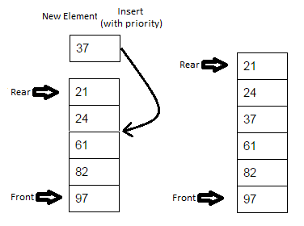
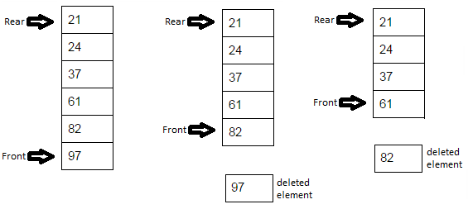
Heaps
Why are we interested in heaps?
Can we perform efficient binary search on heaps?
What about accessing the smallest/largest element?
Max heap provides immediate O(1) access to the largest element
Min heap provides immediate O(1) access to the smallest element
Can this be useful?
Consider priority queues:
Items are processed on first-come-first-serve basis (FIFO)
Every item in the queue has a priority tag
Items of higher priority are pushed in front of the items of lower priority
Items with the highest priority will always be processed first

Slide 5
Heaps
Max-heaps make great priority queues:
Root item is the front of the queue
Perfectly balanced tree structure – path to every leaf is lg n
We need enqueue() and dequeue() algorithms!
97
82 61
37 24 21

Slide 6
Heaps
Heaps are typically implemented using arrays
Successive node values stored in breadth-first manner
parent | left child | right child
0 | 1 | 2
1 | 3 | 4
20
10 15
7 3 7 10
6 5
2 | 5 | 6
3 | 7 | 8
…. | …. | ….
i
2∙i +1
2∙i +2
0 | 1 | 2 | 3 | 4 | 5 | 6 | 7 | 8
20 | 10 | 15 | 7 | 3 | 7 | 10 | 6 | 5

Slide 7

Heaps
For each index i,
element arr[i] has children at arr[2i + 1] and arr[2i + 2]
and the parent at arr$\left\lfloor \text{( }\text{i}\text{ − 1 )/2}\right\rfloor$
parent | left child | right child
0 | 1 | 2
1 | 3 | 4
20
10 15
7 3 7 10
6 5
2 | 5 | 6
3 | 7 | 8
…. | …. | ….
i
2∙i +1
2∙i +2
0 | 1 | 2 | 3 | 4 | 5 | 6 | 7 | 8
20 | 10 | 15 | 7 | 3 | 7 | 10 | 6 | 5

Slide 8
Heaps as Priority Queues: Enqueuing
Enqueue:
Add an element
Make sure the heap properties are preserved
What’s the best place to add an element?
Leftmost leaf position
Why? Because property (2) must be preserved
Enqueue:
Add element to the open leftmost leaf position
Swap the element with its parent while element > parent && element != root
20
10 15
7 3 7 9
6 5
heapEnqueue(el)
put el at the end of heap;
while el is not in the root and el > parent(el)
swap el with its parent;
X

Slide 9
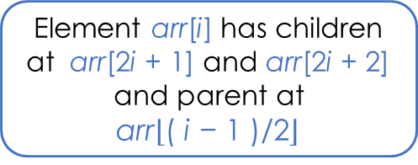
Heaps: Enqueuing
Element arr[i] has children at arr[2i + 1] and arr[2i + 2] and parent at arr$\left\lfloor \text{( }\text{i}\text{ − 1 )/2}\right\rfloor$
4
6
3
7
empty
4
4
6
6
4
6
4 3
6
4 3
7
6
7 3
4
4
4 | 6
6 | 4
6 | 4 | 3
6 | 4 | 3 | 7
6 | 7 | 3 | 4
5
4
7
6 3
4
7
6 3
4 5
7
6 3
4 5 4
7
6 4
4 5 3
7 | 6 | 3 | 4
7 | 6 | 3 | 4 | 5
7 | 6 | 3 | 4 | 5 | 4
7 | 6 | 4 | 4 | 5 | 3

Slide 10
Heaps as Priority Queues: Dequeuing
Dequeue:
Remove root
Make sure the heap properties are preserved
How do we put the two resulting heaps back together?
Preserve property (2): take the rightmost leaf from the lowest level, and make it the new root
Preserve property (1): swap the p=root with its largest child while (p < largest child)
Result:
Extract root
Replace root with the rightmost leaf of the last level
Propagate the new root downwards till heap properties are satisfied
20
10 15
7 3 7 9
6 5
10 15
7 3 7 9
6 5

Slide 11
Heaps as Priority Queues: Dequeuing
heapDequeue()
extract the element from the root;
put the element from the last leaf in its place;
remove the last leaf;
// both subtrees of the root are heaps
p = the root;
while p is not a leaf and p < any of its children
swap p with the larger child;
20
10 15
7 3 7 9
6 5
5
10 15
7 3 7 9
6

Slide 12
Heaps as Priority Queues: Dequeuing
7
6 4
4 5 3
6 4
4 5 3
3
6 4
4 5
6
3 4
4 5
6
5 4
4 3
7 | 6 | 4 | 4 | 5 | 3
7 | 6 | 4 | 4 | 5 | 3
3 | 6 | 4 | 4 | 5
6 | 3 | 4 | 4 | 5
6 | 5 | 4 | 4 | 3
5 4
4 3
3
5 4
4
5
3 4
4
5
4 4
3
6 | 5 | 4 | 4 | 3
3 | 5 | 4 | 4
5 | 3 | 4 | 4
5 | 4 | 4 | 3

Slide 13
Heaps as Priority Queues: Dequeuing
5
4 4
3
4 4
3
3
4 4
4
3 4
3 4
5 | 4 | 4 | 3
5 | 4 | 4 | 3
3 | 4 | 4
4 | 3 | 4
4 | 3 | 4
4
3
3
3
4 | 3
4 | 3
3

Slide 14
“Heapifying” arrays
Given an array of data, how do you convert it into a heap?
Williams algorithm:
Create an empty heap
Insert elements from the array to the heap one by one
Efficiency:
To insert n elements: n insertions
To insert a single element: maximum of lg n upward swaps
Thus: O(n lg n)
Is there a better way?
Floyd algorithm:
Bottom-up: Pretend the given array is already a heap
Set p to the index of the last non-leaf node, set start=p
Enforce heap property (1) by moving start (and its value) down as far as necessary (use loop in dequeuing process)
Set p to the previous non-leaf node
Repeat while p >= 0 (move from last non-leaf to first non-leaf)

Slide 15
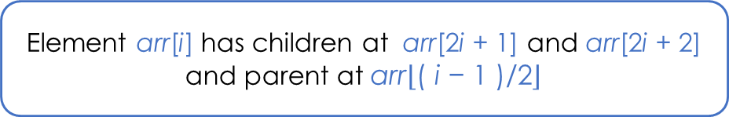

“Heapifying” arrays
How do we find the last non-leaf node?
Thus, take the index of the last element, and calculate the parent:
Index of 5: 8
Parent of 5: $\left\lfloor \text{( 8 − 1 )/2}\right\rfloor$ = 3
Value at index 3: 7
FloydAlgorithm(data[])
i = index of the last nonleaf
while i >= 0
p = i;
while p is not a leaf and data[p] < any of its children
swap p with the larger child;
i = i - 1; // index of the previous non-leaf
20
10 15
7 3 7 9
6 5
Element arr[i] has children at arr[2i + 1] and arr[2i + 2] and parent at arr$\left\lfloor \text{( }\text{i}\text{ − 1 )/2}\right\rfloor$
20 | 10 | 15 | 7 | 3 | 7 | 9 | 6 | 5
0 | 1 | 2 | 3 | 4 | 5 | 6 | 7 | 8

Slide 16
“Heapifying” arrays: Floyd’s Algorithm
4
6 3
7 5 4
7 5 4
Efficiency:
O(n)
6
3
7 5
4
3
That’s better than
O(n lg n)!
4 | 6 | 3 | 7 | 5 | 4
4 | 6 | 3 | 7 | 5 | 4
4 | 6 | 4 | 7 | 5 | 3
last nonleaf
4
7
4 4
6 5 3
7
6 4
4 5 3
7
6 5
4
3
4 | 7 | 4 | 6 | 5 | 3
7 | 4 | 4 | 6 | 5 | 3
7 | 6 | 4 | 4 | 5 | 3

